Slide 1
Applied Data Science Clustering
Dr. Omri Allouche
2017

Slide 2
Centroid-based Algorithms
Guess a K number of clusters
Form the initial clusters
Reiterate the clusters until you notice that your solution doesn’t change anymore

Slide 3
K-Means
Source: http://mcla.ug/blog/k-means-clustering.html

Slide 4
K-Means
Assumes that a class has a “centroid”
Will find clusters even if none exist!
How is distance computed?
What if features are scaled?
When to stop iterating?

Slide 5




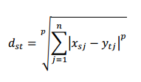




Distance Metrics
 | Manhattan distance
 | Euclidean
 | Minkowsky
 | Chebyshev
 | Mahalanobis
 | Cosine
 | Hamming
 | Jaccard
 | Spearman

Slide 6
Cosine Distance (/ Similarity)
Take the shape more than the values into account
A good choice when there are too many variables and some may not be significant (just noise)
tends to associate observations that have the same maximum and minimum variables, regardless of their effective value

Slide 7
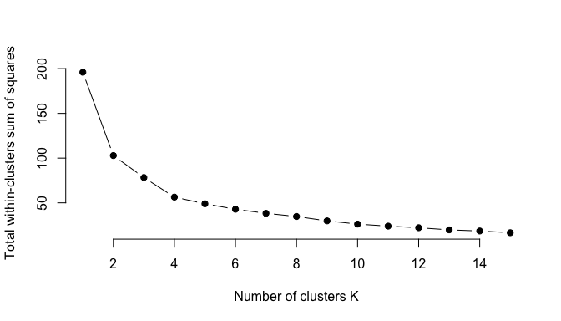
Choosing K: The Elbow Method
Source: http://uc-r.github.io/kmeans_clustering

Slide 8
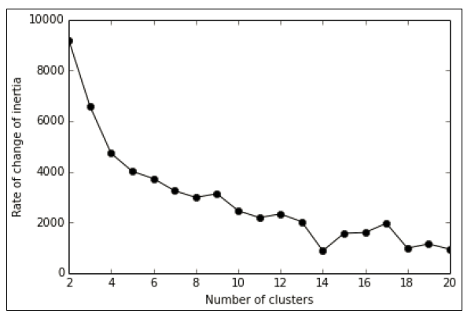
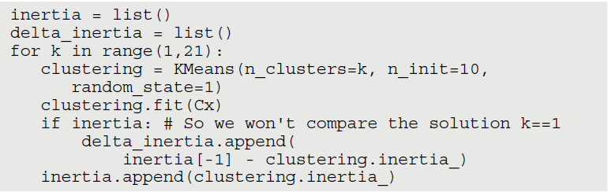
Choosing K: Inertia
Inertia is the sum of all the differences between every cluster member and its centroid. If the examples
in the group are similar to the centroid, the difference is small and so is the inertia.
Inertia is useful when compared to other inertia

Slide 9
K-Means Properties
Must pre-determine K
Stochastic
Generated clusters that are hyper-spherical in nature. Can’t generate clusters with unusual shapes
Tends to generate clusters that are equal in size
Sensitive to outliers

Slide 10
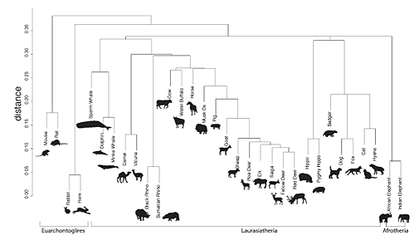
Hierarchical Clustering
Notes:
https://www.york.ac.uk/archaeology/research/featured-research/zooms-1/

Slide 11
Linkage Methods
✓✓Ward: Tends to look for spherical clusters, very cohesive inside and
extremely differentiated from other groups. Another nice characteristic
is that the method tends to find clusters of similar size. It works only
with the Euclidean distance.
✓✓Complete: Links clusters using their furthest observations, that is, their
most dissimilar data points. Consequently, clusters created using this
method tend to be comprised of highly similar observations, making the
resulting groups quite compact.
✓✓Average: Links clusters using their centroids and ignoring their boundaries.
The method creates larger groups than the complete method. In
addition, the clusters can be different sizes and shapes, contrary to the
Ward’s solutions. Consequently, this average, multipurpose, approach
sees successful use in the field of biological sciences.

Slide 12
Hierarchical Models
Provide hierarchy + ability to cut at any point
Don’t scale well – O(n²) as opposed to O(n) for K-means
Deterministic
Can provide different partitionings, at different resolutions

Slide 13
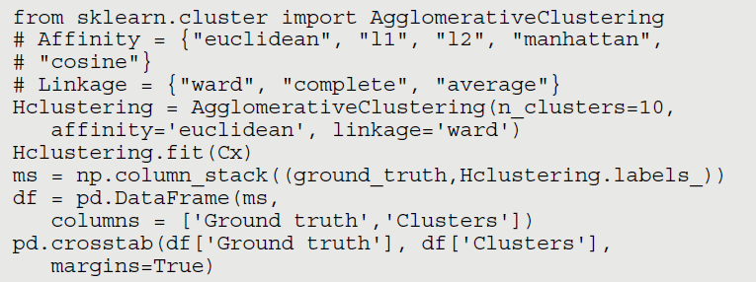

Slide 14
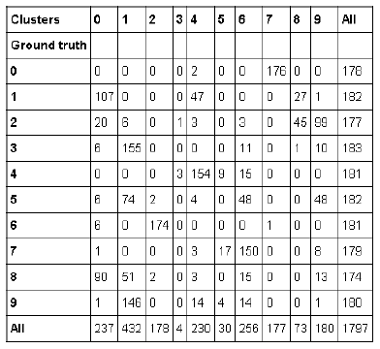
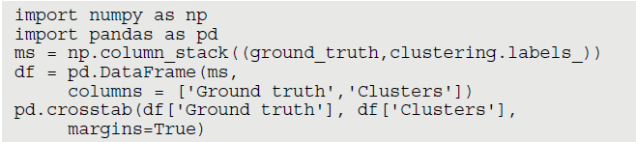

Slide 15
Combining K-means and Hierarchical Clustering
from sklearn.cluster import KMeans
clustering = KMeans(n_clusters=100, n_init=10, random_state=1)
clustering.fit(Cx)
Kx = clustering.cluster_centers_
Kx_mapping = {case:cluster for case,
cluster in enumerate(clustering.labels_)}
from sklearn.cluster import AgglomerativeClustering
Hclustering = AgglomerativeClustering(n_clusters=10, affinity='cosine', linkage='complete')
Hclustering.fit(Kx)
H_mapping = {case:cluster for case, cluster in enumerate(Hclustering.labels_)}
final_mapping = {case:H_mapping[Kx_mapping[case]] for case in Kx_mapping}

Slide 16
Density Based Clusters: DB-Scan
Slower than K-Means, faster than hierarchical clustering
Finds the number of clusters itself
Robust to outliers
Can decide not to cluster points in low-density areas

Slide 17
DB-Scan
Requires setting 2 parameters:
✓eps: The maximum distance between two observations that allows them
to be part of the same neighborhood.
✓min_sample: The minimum number of observations in a neighborhood
that transform them into a core point.
from sklearn.cluster import DBSCAN
DB = DBSCAN(eps=4.35, min_samples=25, random_state=1)
DB.fit(Cx)

Slide 18
